Slide 1
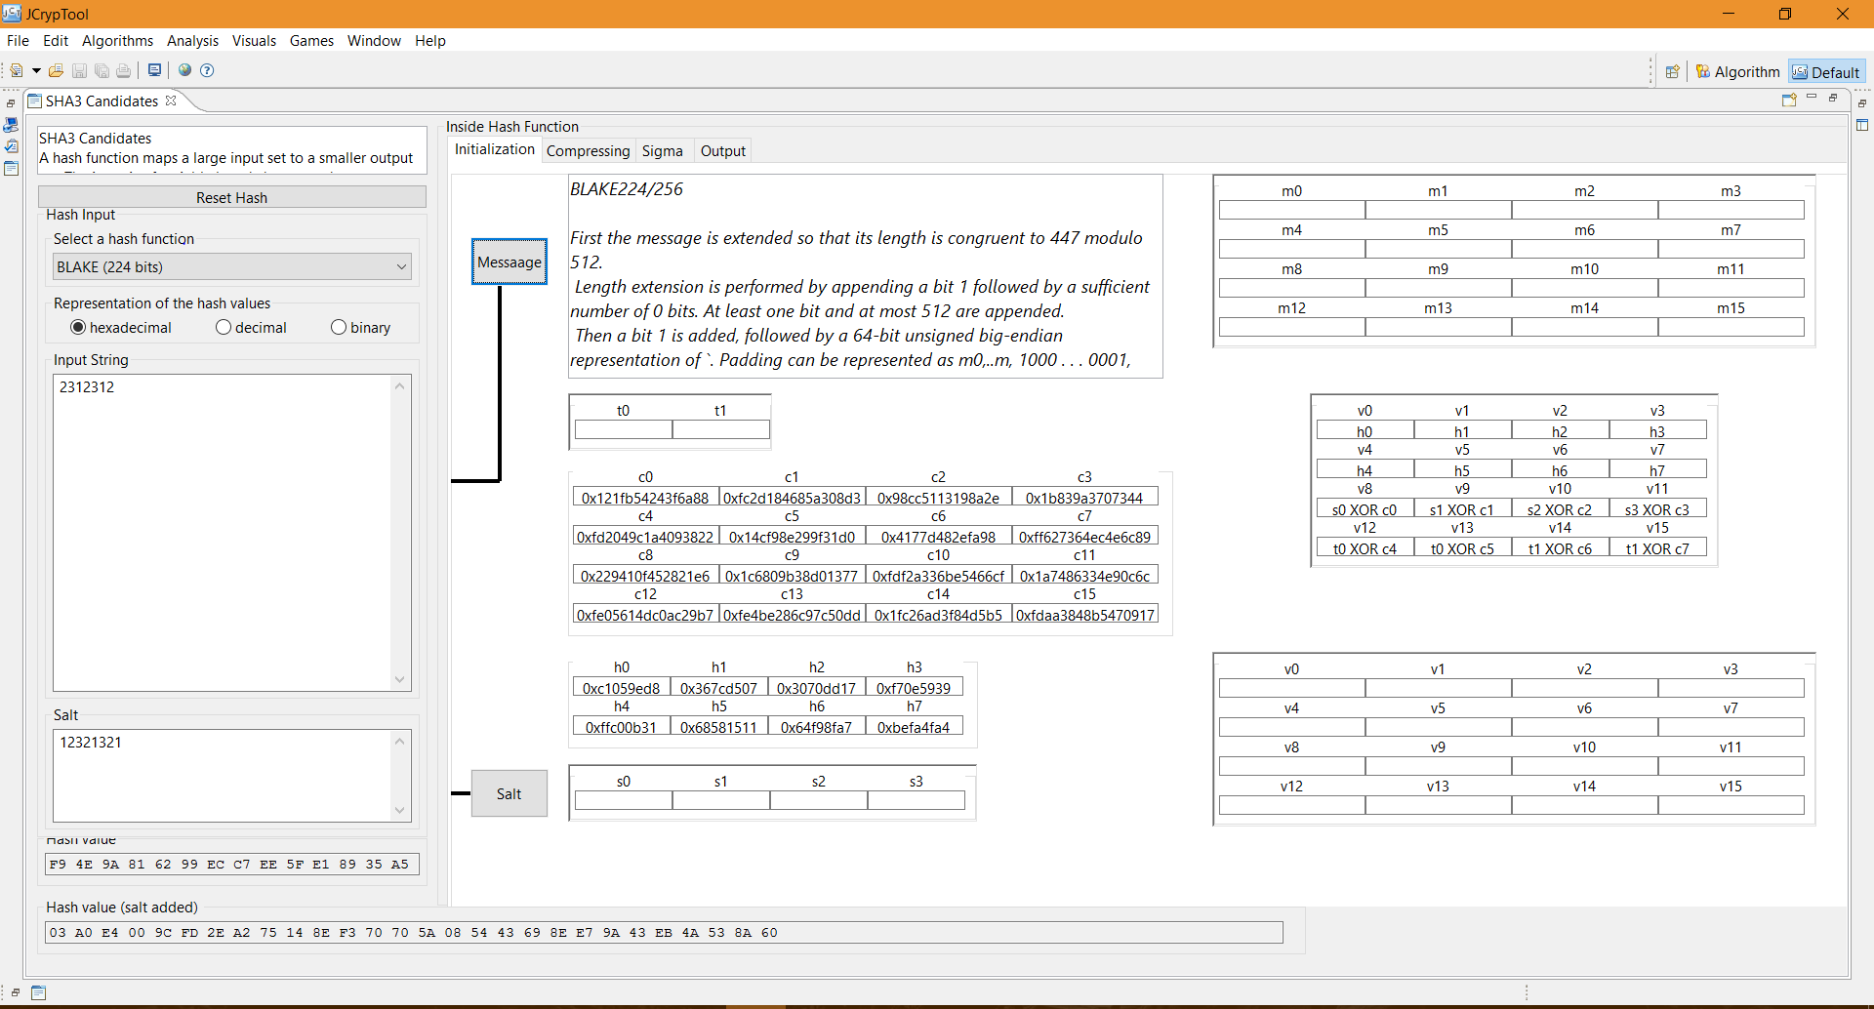
1. Choose BLAKE224
2. Add message
3. Add salt (optional)
Hash output (no salt)
partially displayed
Hash output (salt added)

Slide 2
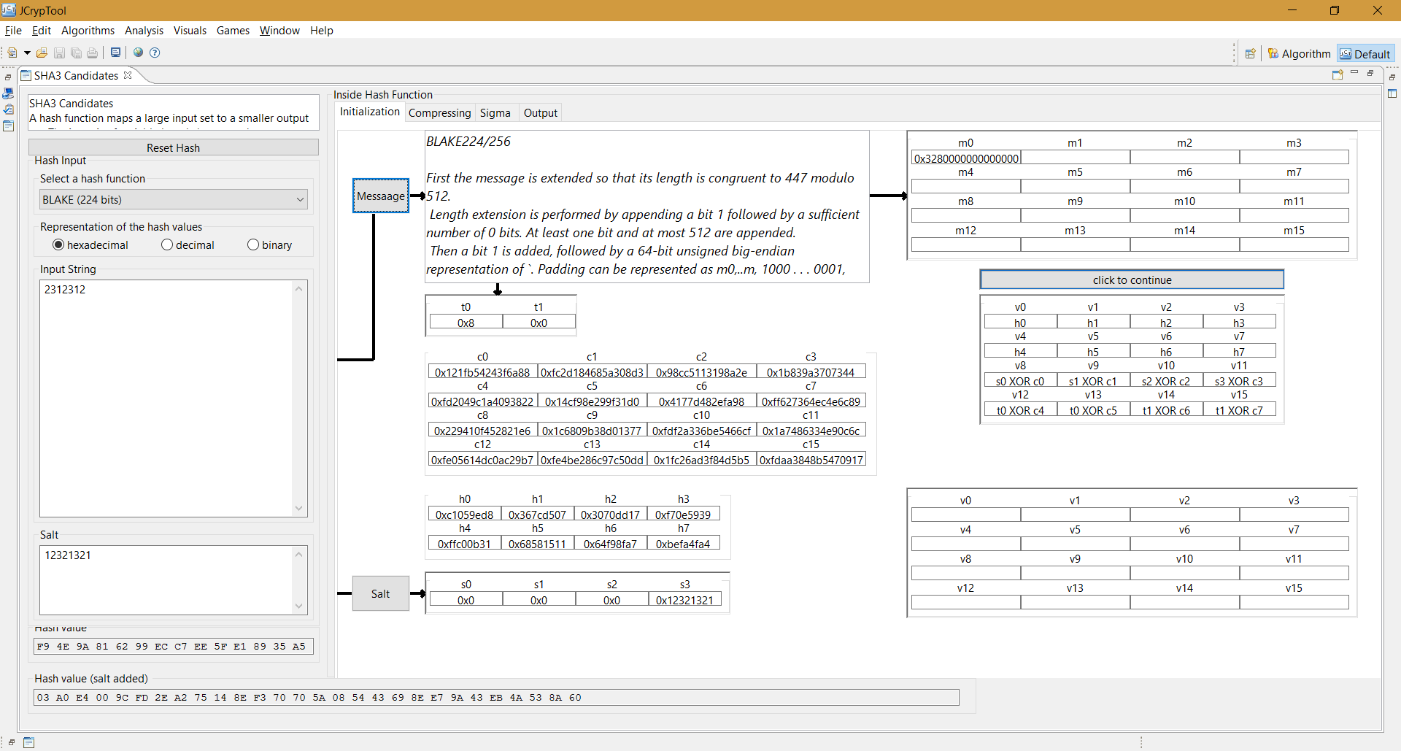
6. Click ‘click to continue’ to continue to substitute the inputs
5. Click ‘Salt’ to add salt

Slide 3
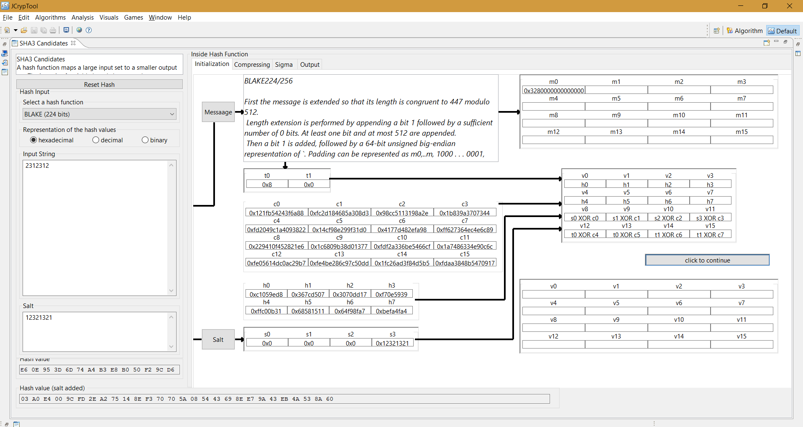
7. Click ‘click to continue’ to get the initial hash states

Slide 4
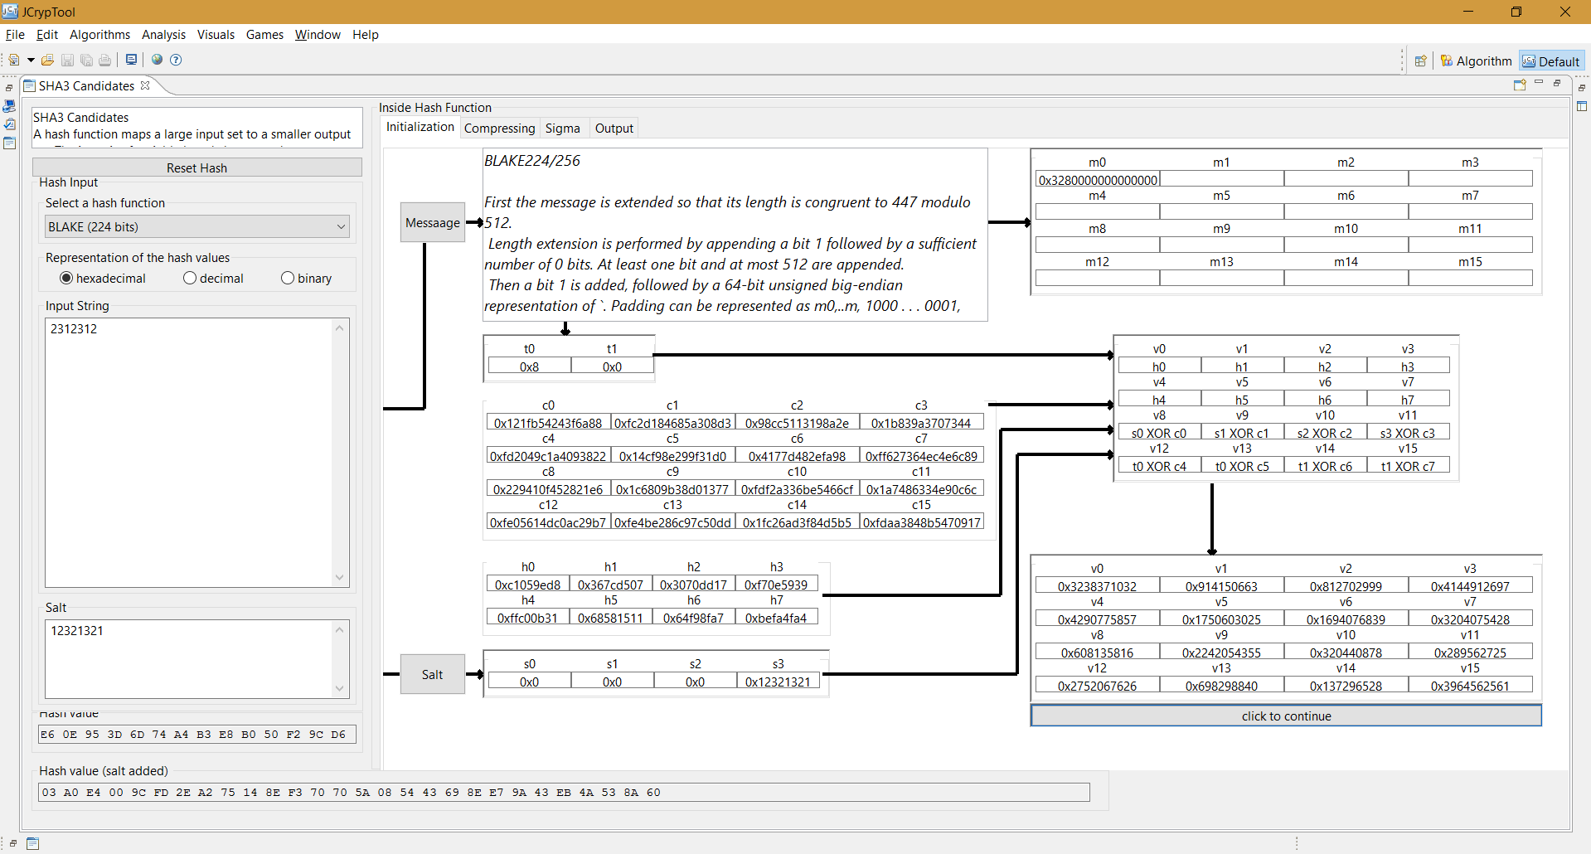
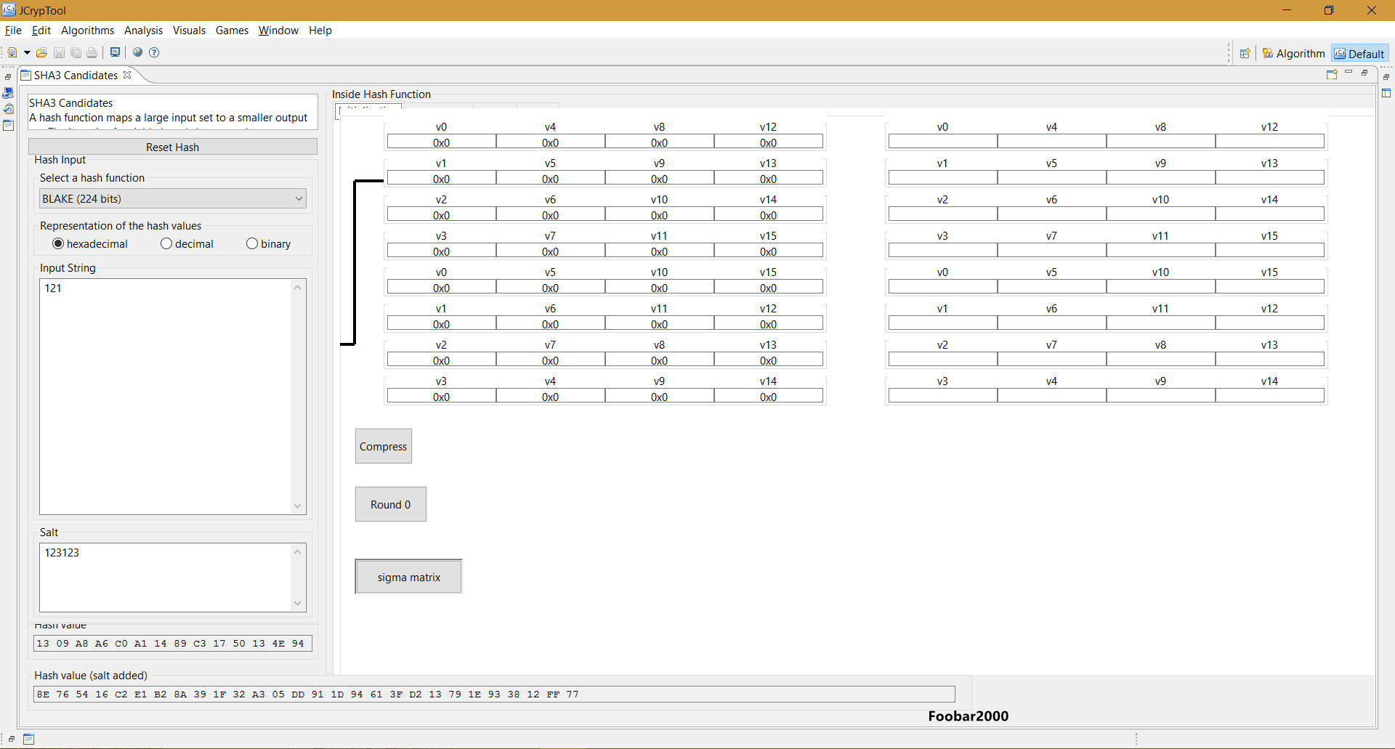
8. Click ‘click to continue’ to jump to the next page

Slide 5
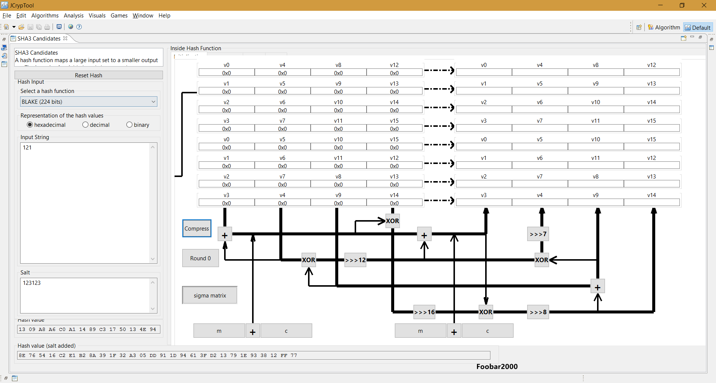
9. Click ‘Compress’ to see the Round Functions

Slide 6
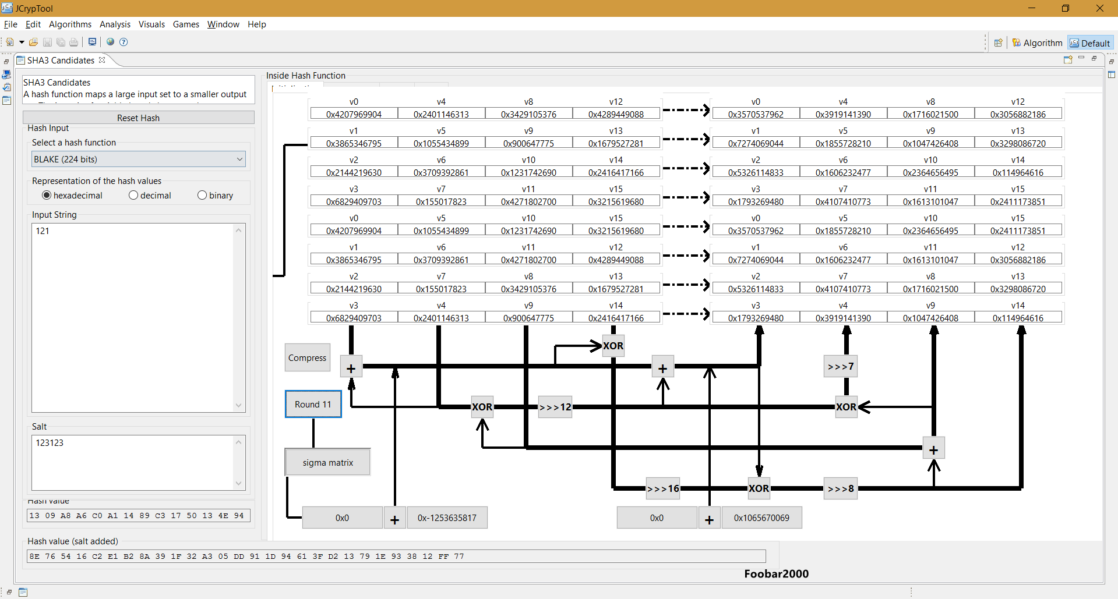
The states are updated in every round
10. Click ‘Round X’ 14 times to finish the 14 rounds

Slide 7
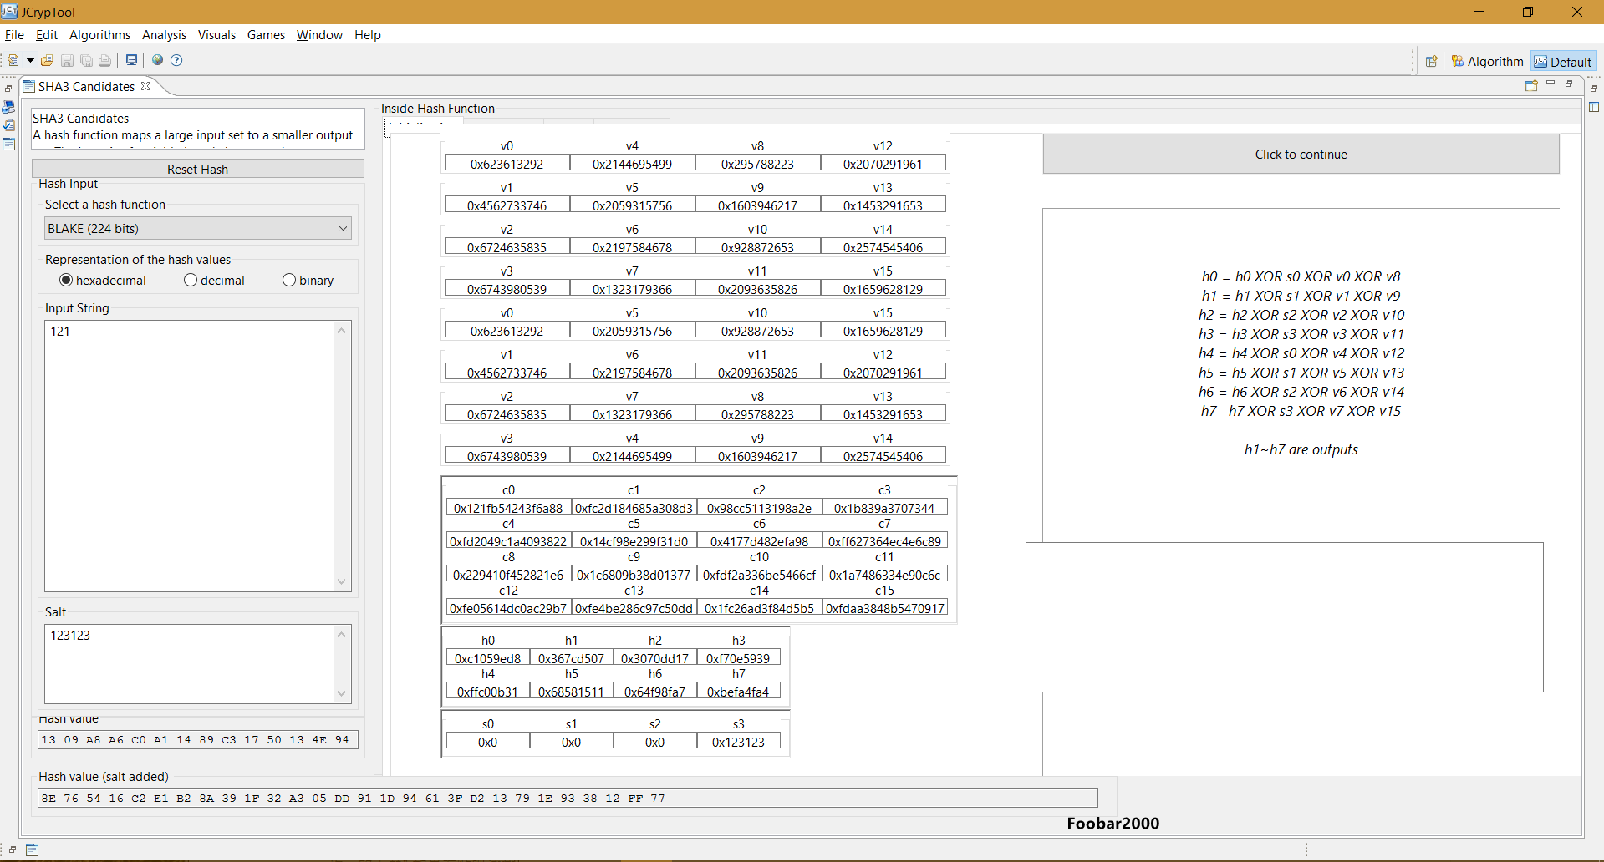
11. Jump to this page automatically after clicking ‘Round X’ for 14 times
12. Click ‘click to continue’ to get the final output

Slide 8
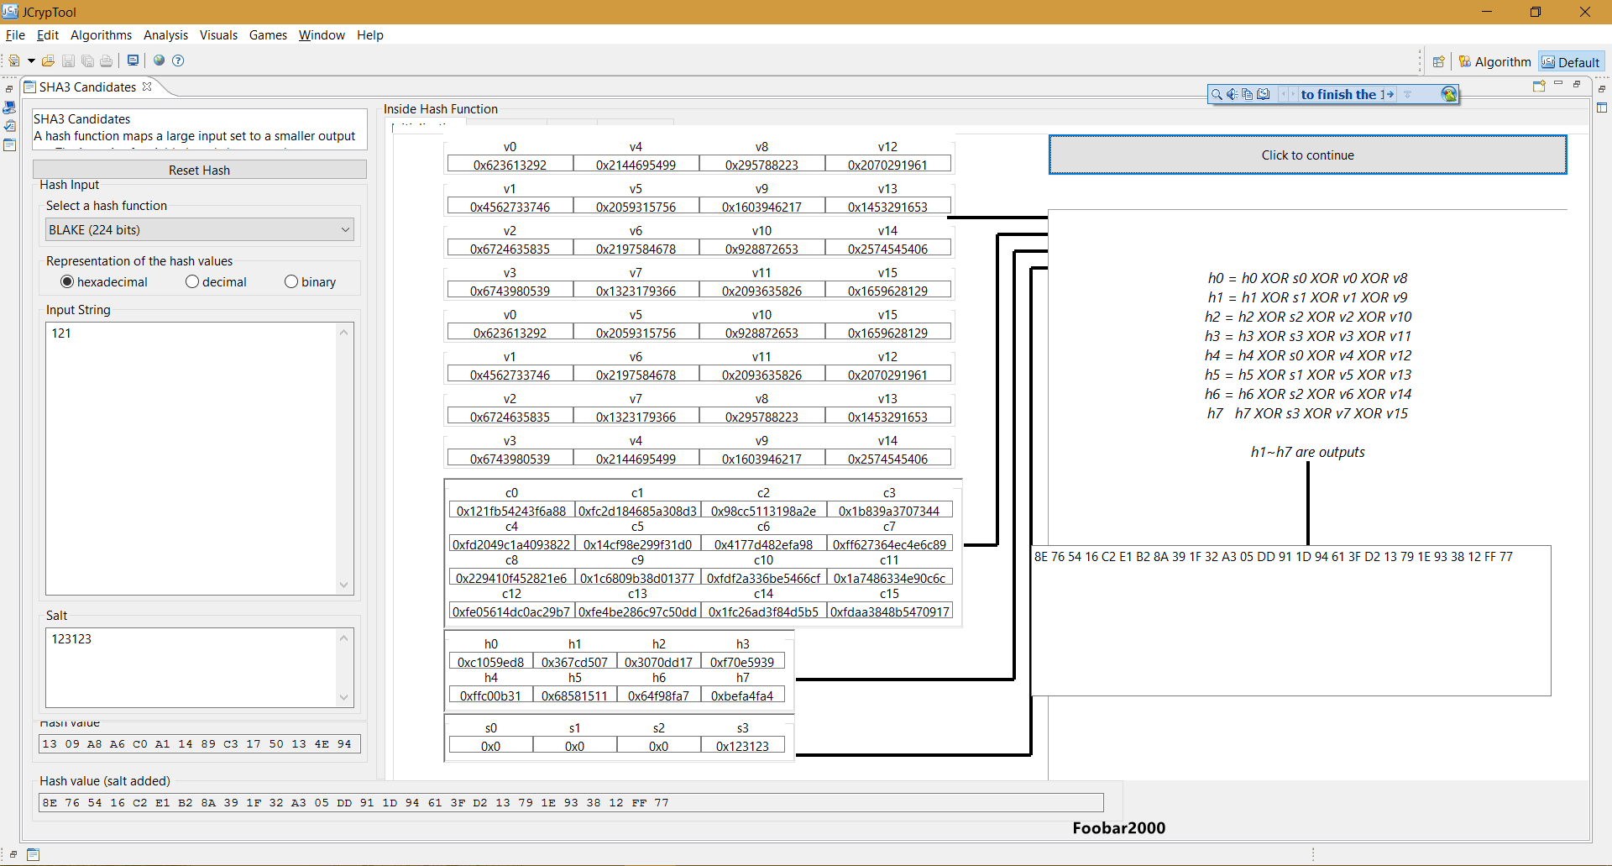
the final output

